Slide 1
Progress update
June 5, 2018
Group 3

Slide 2
Importance of consistency
We must have consistency between chapters
How do we create a common theme connecting the chapters?
Create a graph showing the parallels between chapters, and where we are in the big picture

Slide 3
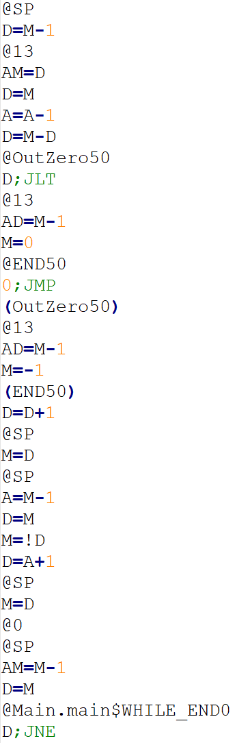
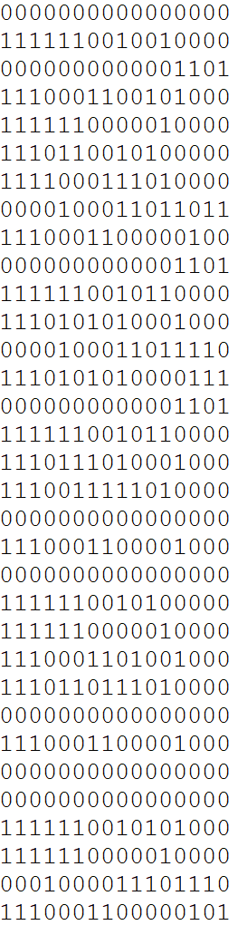
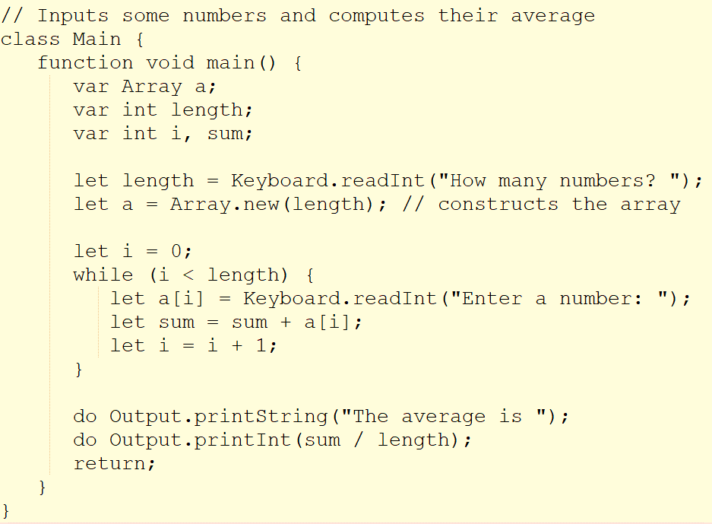
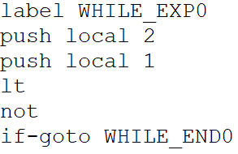
We are now at:
Assembly
Hack
Jack
VM
VM Translator
Compiler
Assembler

Slide 4
Publication work
Completed theoretical part of VM I & II
Proposition: design more exercises for readers, in the format of written questions as well as comparison files to test their programs

Slide 5
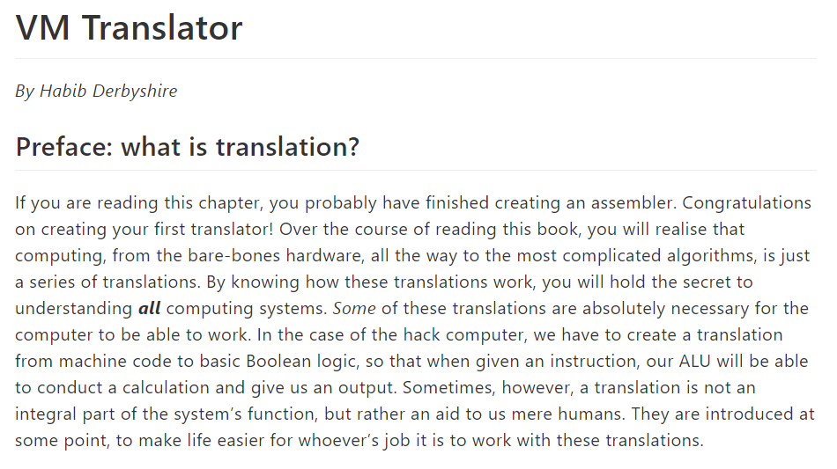
Setting the context:

Slide 6
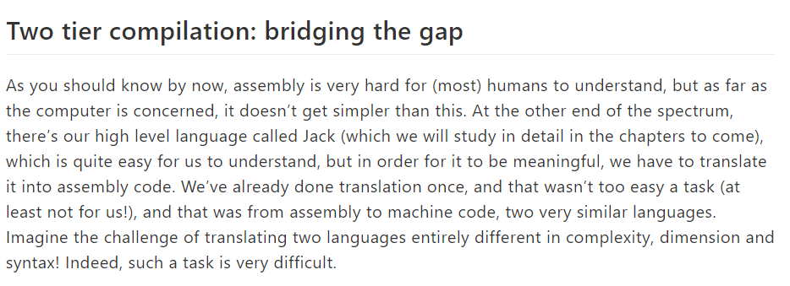
Giving a narrative

Slide 7
Then giving the logic model
Context: An intermediary language known as VM can simplify programming and compilation The stack is a data structure used by the virtual machine abstraction
Goal: 1. Create a virtual machine abstraction and language 2. Have a way of translating the VM language into assembly
Effect Readers should understand the motive behind the VM abstraction Readers should be capable of implementing a translator for our VM language | Output Executable VM programs: make sure you understand the vm language Working VM translations Comparison files to analyze your assembly output | Process Understand the stack architecture Implement basic VM arithmetic commands Understand VM memory access commands Implement memory access commands | Input .vm file Test case
Outside factors: the VM abstraction may seem arbitrary

Slide 8
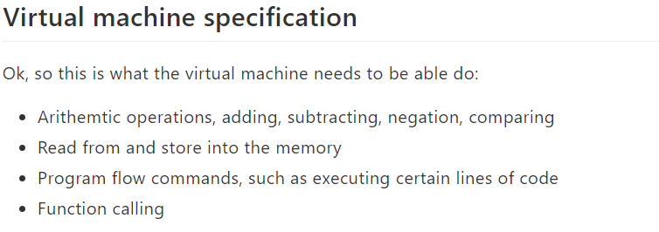
Delving into specifics

Slide 9
SP
SP
3
2
1
1
add

Slide 10
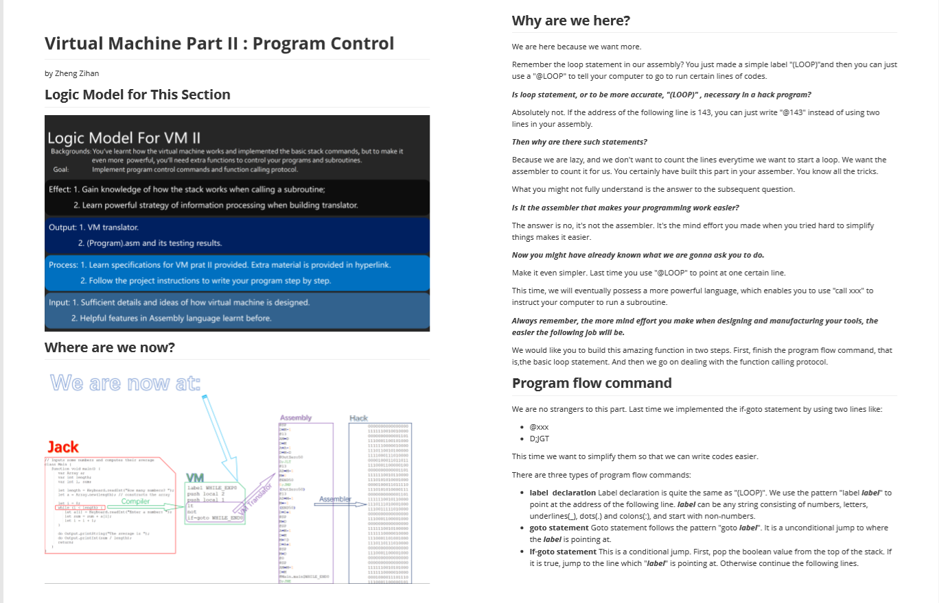
Overview

Slide 11
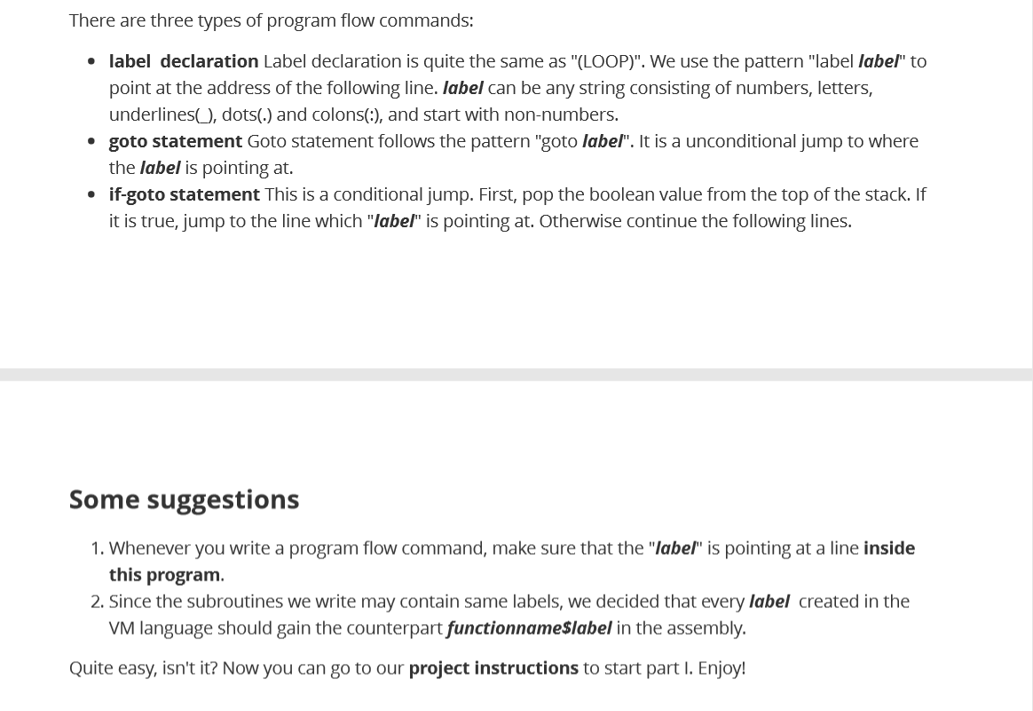
Proper hints at proper places

Slide 12
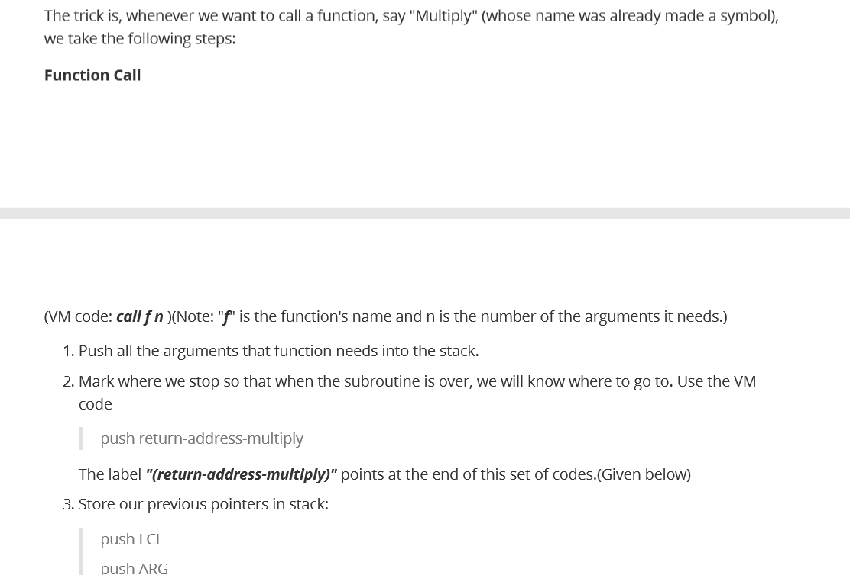
More specific examples

